Slide 1
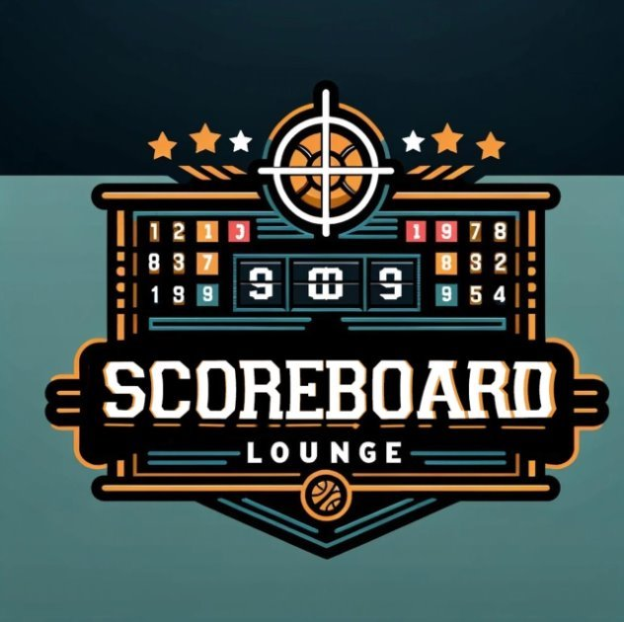
Scoreboard Lounge "A premier destination for sports, dining, and entertainment"
By: Leon Middleton
Notes:
Welcome to the presentation for the Scoreboard Lounge. My name is Leon Middleton, and I am excited to share this business plan with you. The Scoreboard Lounge is a luxury sports bar and lounge that combines an upscale atmosphere with premium dining, innovative entertainment options, and a community-focused experience. Thank you for taking the time to join me.

Slide 2
The Opportunity
Growing demand for upscale sports bars/lounges offering premium experiences.
Lack of local venues that combine luxury dining and live sports entertainment.
Opportunity to create a go-to destination for sports enthusiasts and event hosting.
Notes:
There’s a growing demand for unique, upscale social spaces where sports enthusiasts can enjoy premium services and experiences. Many traditional sports bars fail to cater to customers looking for luxury and personalization. The Scoreboard Lounge fills this gap by creating an environment that blends high-end dining, state-of-the-art entertainment, and a modern, immersive sports-viewing experience.

Slide 3
Company & Solution
Scoreboard Lounge: A luxury sports lounge offering dining, drinks, and immersive sports viewing experiences.
Unique blend of high-quality food, state-of-the-art screens, and live events.
Solves the gap between casual sports bars and high-end lounges.
Notes:
The Scoreboard Lounge is designed to redefine the sports bar experience. We offer a luxurious space with high-quality food and beverages, exclusive seating options, and interactive experiences like live sports trivia and VIP viewing suites. Our focus is on delivering exceptional customer service and creating a welcoming environment where fans can connect, celebrate, and enjoy sports in style.

Slide 4
The Target Market
Demographics: Ages 25–45, mid-to-high income sports fans and professionals.
Psychographics: Social, tech-savvy, values unique experiences.
Market size: $X million locally (insert stats with source citation).
Notes:
Our target market consists of sports fans aged 25 to 54 who appreciate premium services and are willing to pay for a superior experience. This includes professionals, corporate groups, and affluent millennials who value socializing in an upscale setting. According to market research, the U.S. sports bar industry generates over $30 billion annually, presenting a significant growth opportunity for our concept.

Slide 5
The Competition
Competitors: Local sports bars, chain restaurants (e.g., Buffalo Wild Wings, Society Hookah Lounge, Bar 919, & Shark Bar & Seafood House).
Competitive Advantage: Luxury ambiance, curated experiences, and personalized customer service.
Notes:
While there are many sports bars in the market, most focus on traditional environments with limited differentiation. Competitors like local sports bars and national chains fail to cater to the premium segment. The Scoreboard Lounge stands out with its luxurious design, personalized customer experiences, and exclusive offerings like specialty cocktails and private viewing areas, giving us a strong competitive edge.

Slide 6
Management and Operations
Team: Experienced hospitality professionals and sports enthusiasts.
Facilities: High-tech lounge with modern decor, private viewing spaces, and event-hosting areas.
Notes:
Our team consists of experienced professionals in hospitality, event management, and marketing. Together, we bring the expertise needed to manage operations effectively and deliver a top-tier customer experience. The Scoreboard Lounge will operate from a state-of-the-art facility that includes high-end audiovisual systems, comfortable seating, and a modern kitchen to support our premium menu offerings.

Slide 7
The Marketing Strategy
Focus on SEO (11.1%), social media ads (18.5%), and local partnerships.
Weekly content strategy: blogs, social media teasers, and behind-the-scenes videos.
Track results through analytics platforms to optimize campaigns.
Notes:
Our marketing strategy focuses on creating brand awareness and driving customer engagement through a combination of digital marketing, local partnerships, and events. Key tactics include targeted social media ads, influencer collaborations, and exclusive events like grand openings and themed game nights. Success will be measured through key performance indicators, including customer retention rates, sales growth, and marketing ROI.

Slide 8
The Timeline
Year 1: Launch and build brand awareness.
01
Year 2: Expand customer base and host high-profile events.
02
Year 3: Explore additional revenue streams (e.g., franchising, merchandising).
03
Notes:
We’ve outlined a clear timeline to bring the Scoreboard Lounge to market. Initial funding and renovations are expected to be completed within the first six months. By the end of Year 1, we aim to establish a loyal customer base through strategic marketing campaigns. By Year 3, we project profitability and plan to explore expansion opportunities, including franchising and additional locations.

Slide 9
Financials
Overview:
Start-up cost: $1,121,076 (renovations, inventory, licensing, and marketing).
Revenue and profit projections for the first three years:
Year 1:
Net Sales: $57,727 | Gross Profit: $28,572
Expenses: $1,024,934 | Loss: -$996,363
Year 2:
Net Sales: $131,825 | Gross Profit: $72,616
Expenses: $1,215,170 | Loss: -$1,142,555
Year 3:
Net Sales: $1,623,142 | Gross Profit: $891,142
Expenses: $1,573,142 | Profit Before Taxes: $1,533,288
Notes:
The financial plan for the Scoreboard Lounge outlines our expected investment needs, revenue projections, and profitability milestones.
We anticipate start-up costs of $1,121,076, which cover facility renovations, licensing, initial inventory for premium beverages and snacks, and the launch of strategic marketing campaigns.
In Year 1, we expect net sales of $57,727, resulting in a gross profit of $28,572. However, initial expenses of $1,024,934 will yield a loss of $996,363 as we establish our brand and operations.
By Year 2, net sales will grow to $131,825, with a gross profit of $72,616, though we still anticipate a loss of $1,142,555 as we continue scaling.
Our turning point will occur in Year 3, where projected net sales are $1,623,142, with a gross profit of $891,142. After expenses, this will lead to a profit of $1,533,288, marking our first profitable year.
Our financial goals are clear: to achieve profitability by Year 3 while maintaining sustainable growth.

Slide 10
Funding
Investment Ask:
Total financing required: $1,100,000 (equity investment).
Use of Funds:
Facility enhancements, licensing, and equipment.
Marketing campaigns to drive brand awareness and customer acquisition.
Scaling operations to reach profitability by Year 3.
Investor Opportunity:
Offering 30%-50% annual return over the first three years.
Notes:
To make this vision a reality, we are seeking $1,100,000 in equity investment. These funds will be strategically allocated to facility enhancements, essential operational costs, and marketing initiatives aimed at building our customer base and driving revenue growth.
We are offering investors an attractive opportunity with a potential annual return of 30% to 50% over the first three years. This funding will provide the foundation we need to establish the Scoreboard Lounge as the premier destination for luxury sports entertainment in our market.

Slide 11
Investment Opportunity
Return Potential:
Profitability by Year 3 with projected profit of $1,533,288.
Revenue growth rates:
Year 1: 1807%
Year 2: 1052%
Year 3: 1581%
Key Performance Indicators (KPIs):
Customer Retention: 50% repeat customer rate by Year 2.
Profit Margin: Positive margin in Year 3.
Marketing ROI: Marketing expenses below 10% of revenue by Year 3.
Exit Strategy: Potential options: resale, franchising, or IPO.
Notes:
The Scoreboard Lounge presents a compelling investment opportunity with clear growth potential.
By Year 3, we project a profit of $1,533,288, with impressive revenue growth rates of 1807% in Year 1, 1052% in Year 2, and 1581% in Year 3.
Our focus on key performance indicators ensures a strong operational foundation. We aim to achieve a repeat customer rate of 50% by Year 2 and maintain marketing expenses below 10% of revenue by Year 3.
For investors, we’re offering several exit strategies, including potential resale, franchising opportunities, or even a public offering. With these plans in place, we’re confident that the Scoreboard Lounge is positioned for long-term success.

Slide 12
Conclusion
Recap: The Scoreboard Lounge is a game-changing concept in sports entertainment.
Thank you for your time and consideration.
Contact details for follow-up questions or investment inquiries.
Notes:
Thank you for taking the time to learn about the Scoreboard Lounge. As you’ve seen, we have a clear vision, a strong financial strategy, and a focused plan to deliver a unique and profitable sports entertainment experience.
We believe this is a tremendous opportunity for investors to be part of an innovative concept with significant growth potential and substantial returns.
Your support will help us bring the Scoreboard Lounge to life and redefine the luxury sports bar experience for our target market.
We appreciate your attention and look forward to the opportunity to collaborate and answer any questions you may have. Thank you!

